Slide 1
Generative Models

Slide 2

Today’s Agenda
Generative Language Models
Machine translation
Large language models
Auto-regressive (large) language models
Pre-trained LLMs
Generative Vision Models (Depending on time)
Generative Image Models (VAEs, GANs)

Slide 3
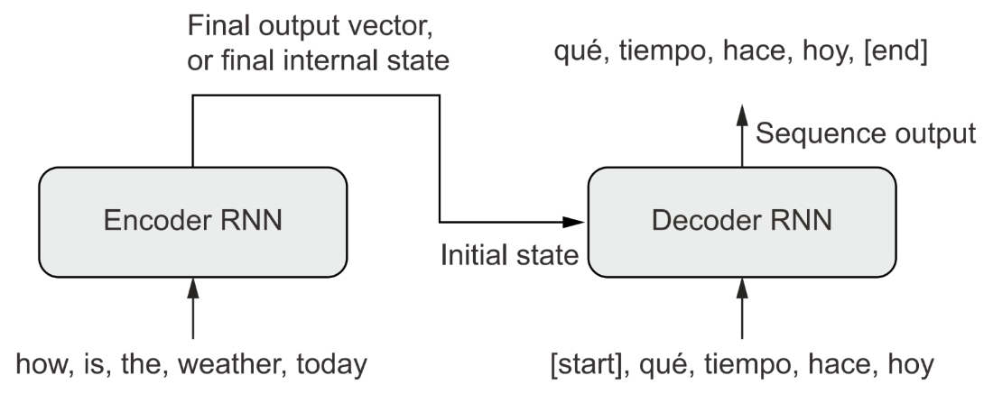
Recall: Machine Translation
Similar Idea with Some Additions
Include an ‘encoder’ that first processes the entire input sequence to obtain an embedded representation of the input text.
We are not just generating ‘plausible’ text now; we are generating plausible text that aligns with (i.e., conditioned upon) the input text.
Our encoder can be bidirectional, but our decoder must be unidirectional. Why?
Notes:
If we have a bidirectional decoder, it will read ahead in the target sentence and cheat, using information that will not present at inference! There won’t be any error messages, but the model is essentially learning how to operate under the presence of information that will never be present in its sequence embeddings for the output generated thus far.

Slide 4
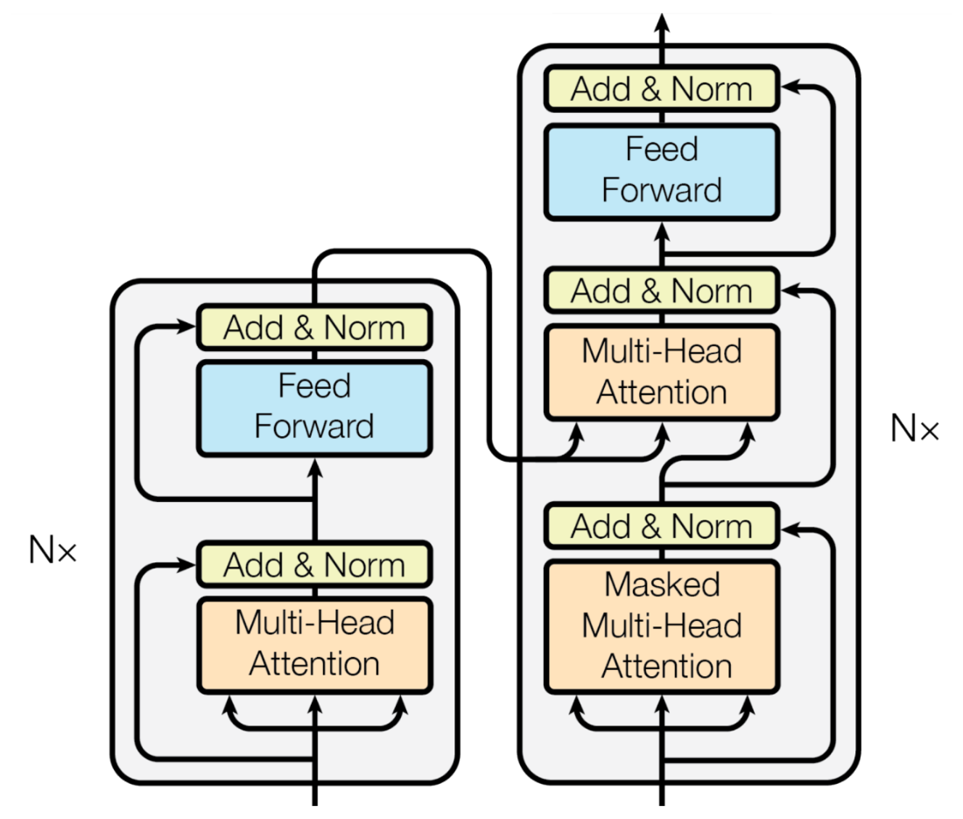
Machine Translation with Transformers
Replace RNNs with Transformers
Transformers are an architecture that wraps MultiHeadAttention(). We have some residual connections inside and some LayerNormalization() operations, with a couple of Dense layers on the output.
We also need to create a special masking layer to prevent the Transformer from looking ahead in the target sequence.
Our decoder uses cross-attention. It compares the representation of the Spanish output seen thus far to the entire English sequence representation.
Notes:
Encoder is on the left and Decoder is on the right. Our Encoder learns attended representations of the English input sequence. Our decoder uses cross-attention to compare an attended representation of the Spanish output seen so far with the input attended English sequence, to decide what to spit out next.

Slide 5
Translation with Self- and Cross-Attention
1. First, Self-Attention in Spanish Sequence (words output so far), i.e., with masking.
2. Second, Self-Attention in English Sequence (entire sequence).
3. Finally, Cross-Attention Comparison.
Query: The attended representation of the Spanish sequence (generated so far) acts as the query. "Given what I've generated in Spanish already, what information from the English sentence is most relevant to predicting the next word?”
Key and Value: The attended representation of the entire English sentence acts as both the "key" and "value." The "key" is used to compute attention weights (how much each English word should be attended to), and the "value" is the information that gets weighted and incorporated into the Spanish sequence.
4. Apply the Attention Weights to English Representation: The attention weights from comparing the query (Spanish) and key (English) are applied to the value (English). This results in a context vector representing the most relevant information from the English sentence for predicting the next Spanish word.

Slide 6
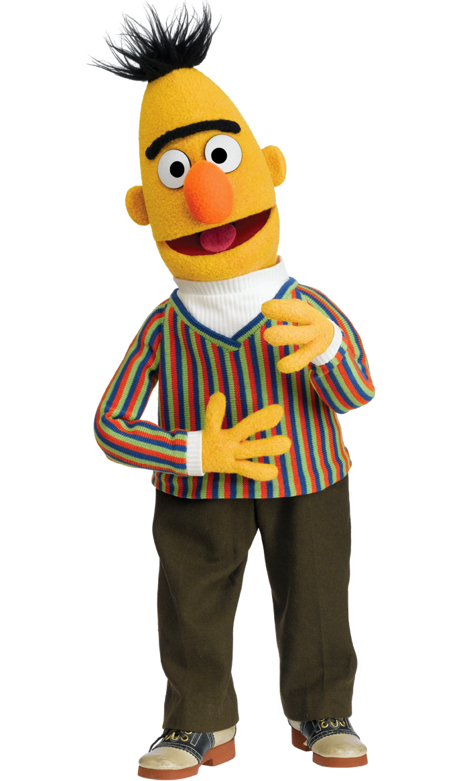
Multi-Head Attention in Other Text Tasks
BERT Embeddings
Bidirectional Encoder Representations from Transformers.
Employs a similar (self-supervised learning) technique as Word2Vec. Mask 15% of words at random in any given sequence and then try to predict those using the words that are not masked.
Word2vec is nice but yields static (generic) embeddings for a given word. BERT learns context-dependent representations. This can dramatically improve the predictive performance of, say, a text classifier.
Notes:
TRANSITION: We've been looking at attention for generation (translation, next-token prediction). Now let's flip it — what if we use attention not to generate text, but to learn better representations of text? That's BERT.

Slide 7
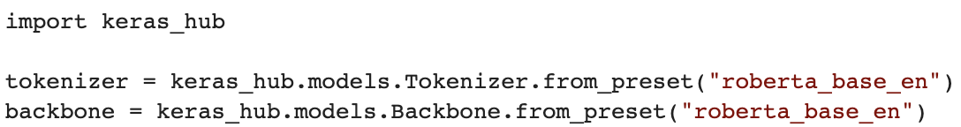
Common Use Case: Sentence Embeddings
Mean Pooling of Contextual Word Embeddings
For a given sentence, you can extract the contextual word embeddings from *after* the MultiHeadAttention layers and then average them.
Pre-Trained BERT Classifier
Or load a pre-trained BERT model’s transformer and embedding layers (backbone / base layers) to pre-process your text and obtain contextual embeddings for a given prediction task.
Or, load the embedding and attention layers, freeze them, and add your Dense layers on top like we did with pre-trained vision models.
Notes:
BERT would also attempt to predict from one sentence whether another appeared next in the original document, to learn sentence-to-sentence relationships.

Slide 8
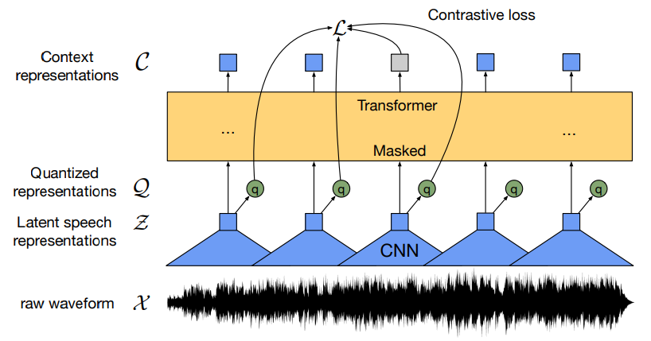
Multi-Head Attention for Audio Representations
Wav2Vec for Audio Understanding
Wav2vec implements a self-supervised learning architecture with random masking of sequence input for audio.
The model first obtains 1D convolutional feature maps per chunk/segment of raw audio signal (spoken words), yielding sequences of feature maps.
A random subsample of feature maps is masked, and the model tries to predict them from the feature maps that remain visible. This model then yields audio embeddings highly representative of spoken semantic content in audio.
Notes:
BERT would also attempt to predict from one sentence whether another appeared next in the original document, to learn sentence-to-sentence relationships.

Slide 9

‘Physics’ Representations from Video
Notes:
BERT would also attempt to predict from one sentence whether another appeared next in the original document, to learn sentence-to-sentence relationships.

Slide 10
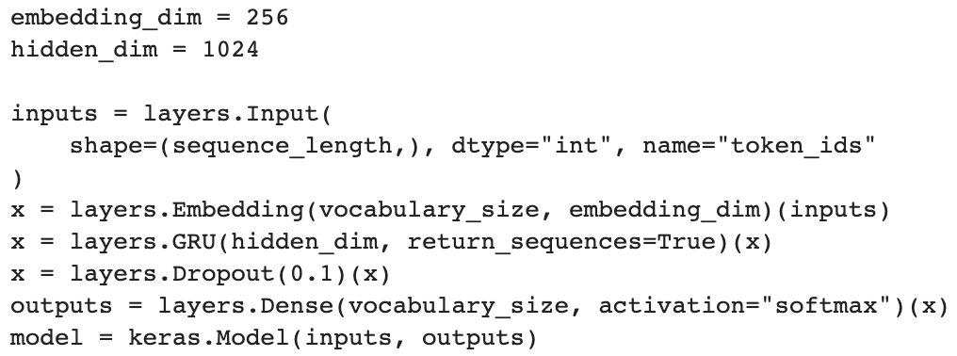
Generative RNN
Training a Generative Language Model
We train a model to predict the next token at every position in a sequence of observed input tokens.
We will not use this exact model for inference; we will modify it slightly and add a feedback loop to make auto-regression possible.

Slide 11
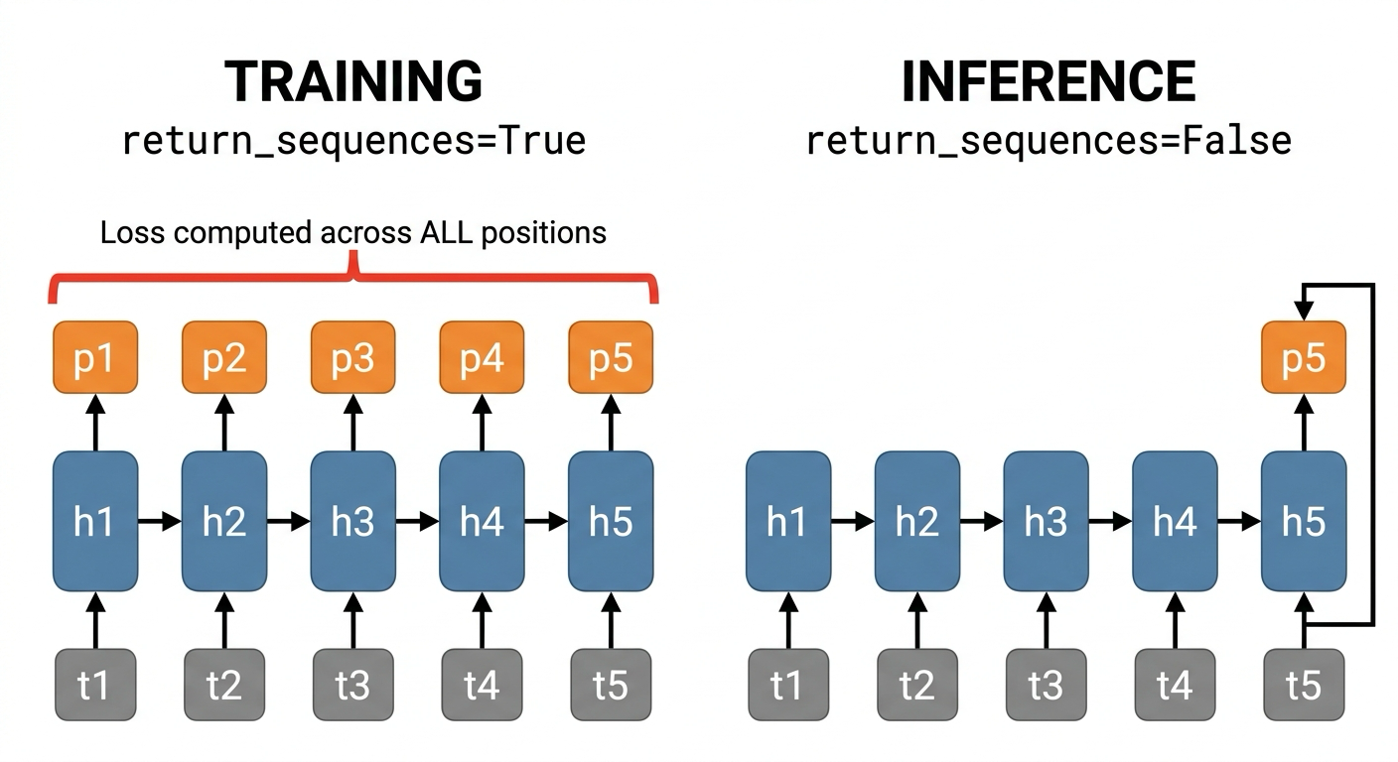
In Training: Loss at Each Sequence Position
Training: Predict All Positions in Parallel
During training, we already know the full sequence. So, we compute loss at every position simultaneously. This is purely an efficiency trick — it does not mean the model "sees the future." Our model predicts one prediction per token in the sequence, in parallel.
Example (character-level):
Position 0: model sees [S] → predicts 'h'
Position 1: model sees [S, h] → predicts 'a'
Position 2: model sees [S, h, a] → predicts 'k'
Position 3: model sees [S, h, a, k] → predicts 'e'
Position 4: model sees [S, h, a, k, e] → predicts 's'
All 5 predictions happen in ONE forward pass, together. Loss = average of all 5 cross-entropy values.
Inference: One Token at a Time
At inference, we set return_sequences = False. We generate one token only, feed it back as input, and repeat. Same weights, just a different loop.
Notes:
Note: we do something similar with a transformer. The difference, however, is that transformers do not process in sequence. As such, instead, we include a ‘causal mask’, such that predictions at different points in the sequence are made based on attention that ignores tokens later in the sequence. This forces the model to only consider information it will have at inference time.

Slide 12
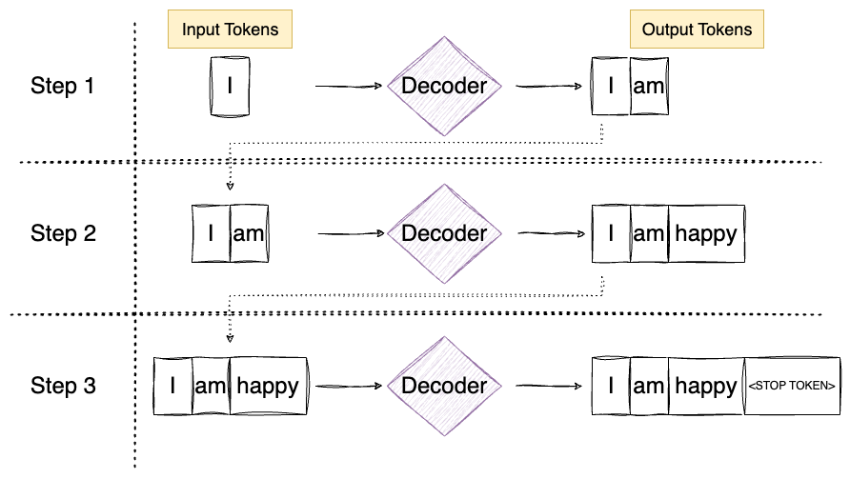
Generative Language Model
Inference with Generative Language Models
We modify the layer to only produce a single output token (return_sequences = False).
We then wrap the new layers with a feedback loop that takes the last prediction and passes it as input to the model again along with the most recent embedding that captures ‘what we’ve done so far’.

Slide 13
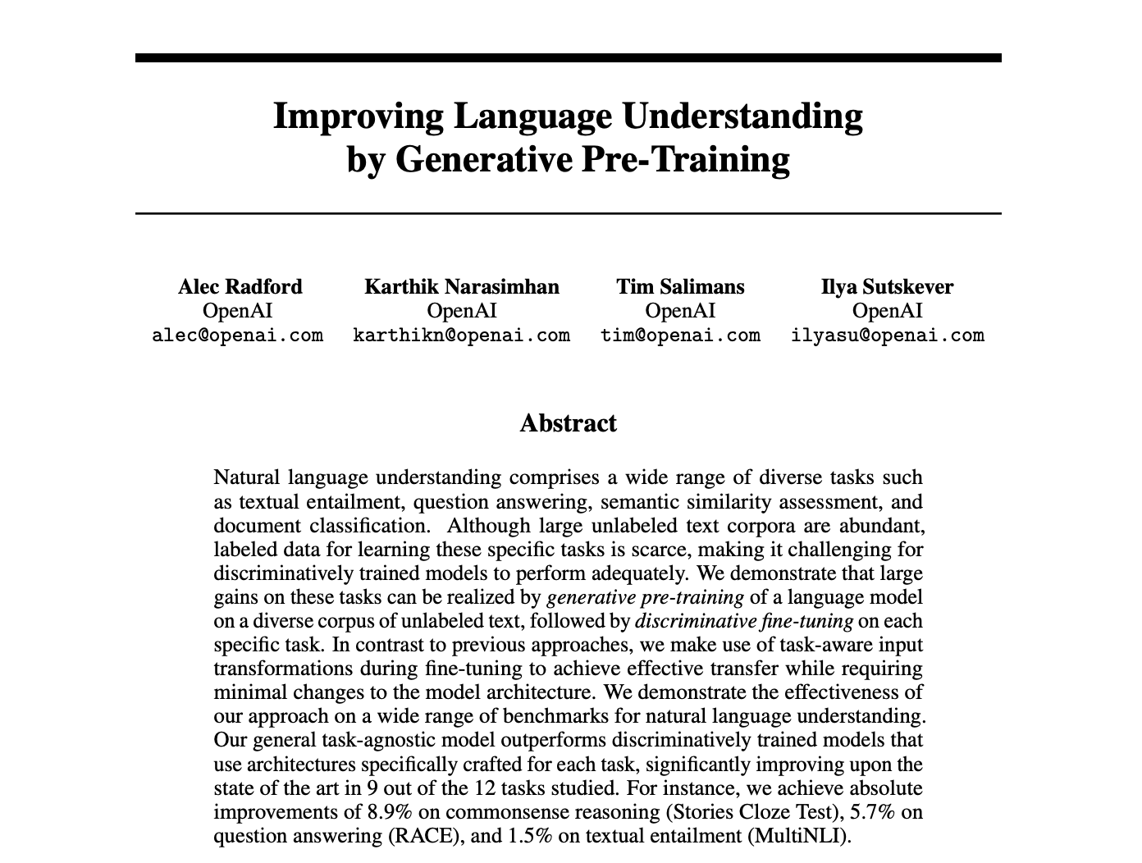
Generative Pre-trained Transformers
Generative Pre-trained Transformers (GPTs)
In 2018, not long after “Attention Is All You Need,” OpenAI put out a paper about the efficacy of scaling data and compute with a mixture of basic ingredients: i) vast amounts of highly varied text, ii) a generative language architecture, and iii) transformers (oh, and RLHF).
GPT-1 (2018) had 117 million parameters trained on 10 million tokens.
GPT-2 (2019) had 1.5 billion parameters and was trained on 10 billion tokens.
GPT-3 (2020) had 175 billion parameters and was trained on 300 billion tokens.

Slide 14

GPTs (and LLMs Generally) Have Many Problems
Various Challenges with LLMs (Among Many Others)
Hallucination: They produce plausible text as output, not necessarily truthful or correct text. Therefore, they are highly dependent on the quality of training data.
Prompt Brittleness: Rewording a prompt even slightly can lead to considerable changes in model response. For example, if you ask the same question of an LLM in different languages, you can get very different answers (conceptually and semantically)!
Memorization: Assessing the performance of LLMs on various task benchmarks is quite challenging because it is often tough to assess whether the model has seen the problem previously and is merely looking up the answer in training data. This affects whether performance reflects how a model might perform on an entirely new task.
Notes:
The host of issues is very extensive. Be careful what intelligence you ascribe to these models, or what you trust them to do.

Slide 15
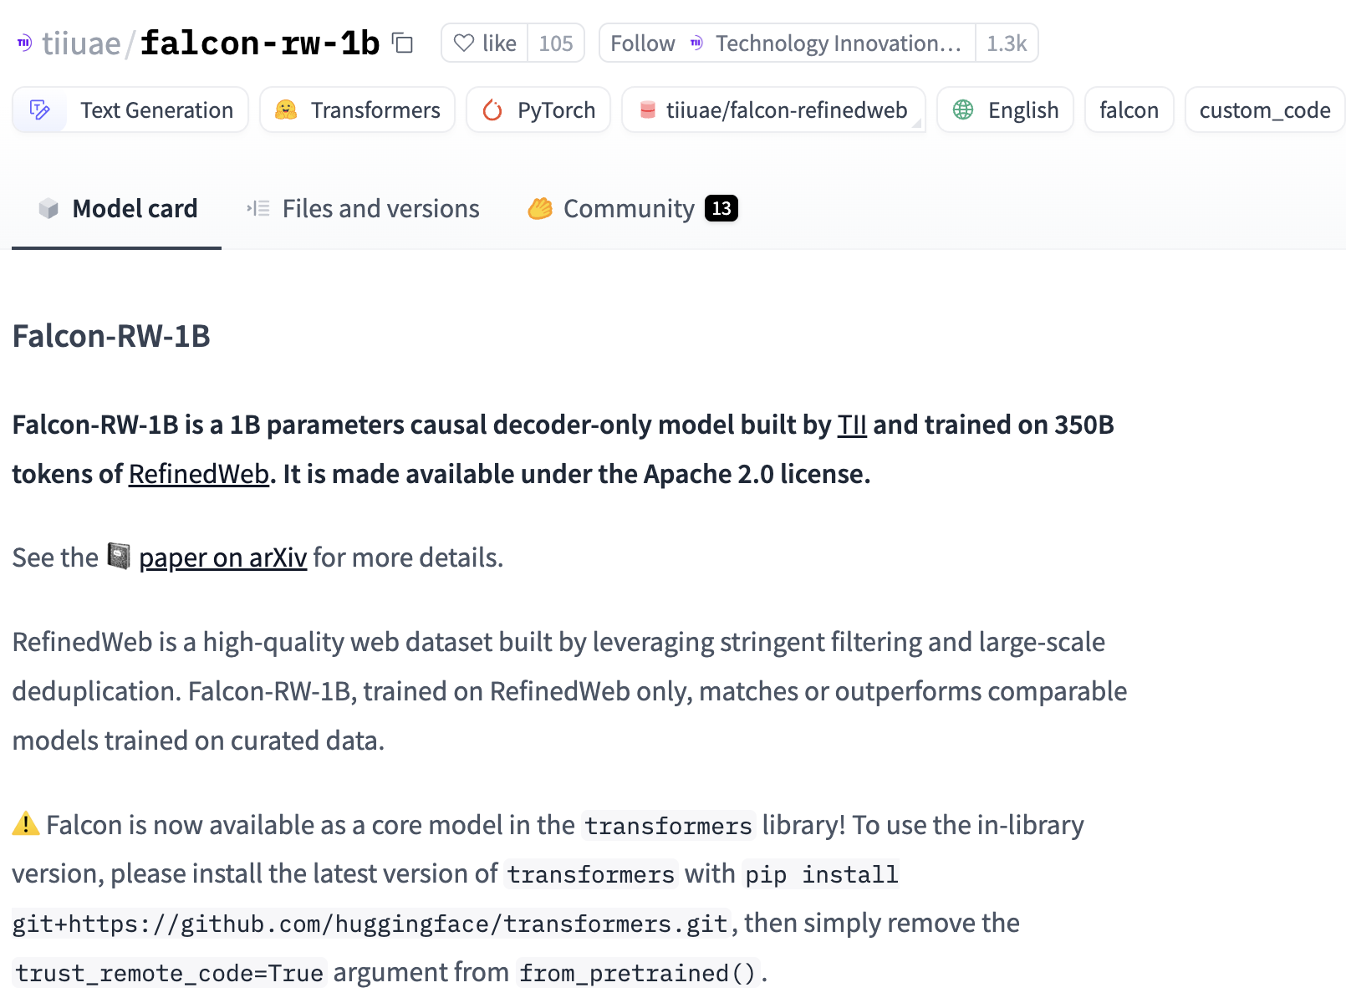
Lots of Pre-Trained LLMs Around
Loading Pre-trained Models from Keras Hub
Check out what is available on the Keras hub. Many open-source and free-to-use models are there, though many are too large for a Colab notebook.
Kaggle hosts some of the models. For a given model, you may need to visit Kaggle and create an API key, complete a request form, or agree to terms and conditions.

Slide 16
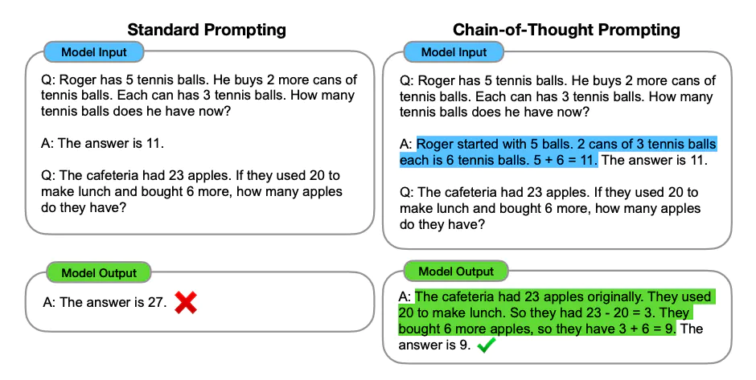
LLM Prompting Strategies (In-Context Learning)
Demonstrations vs. Reasoning Traces
Zero-shot vs. Few shot: Just ask the model to answer a question (zero-) vs. provide ‘good’ prompt response pairs as examples while asking the model to answer a question (few-).
Chain of Thought (CoT): Provide examples of question + reasoning process + answer. Note: not the same as reasoning / thinking models, which are models that are pre-trained on reasoning traces.

Slide 17
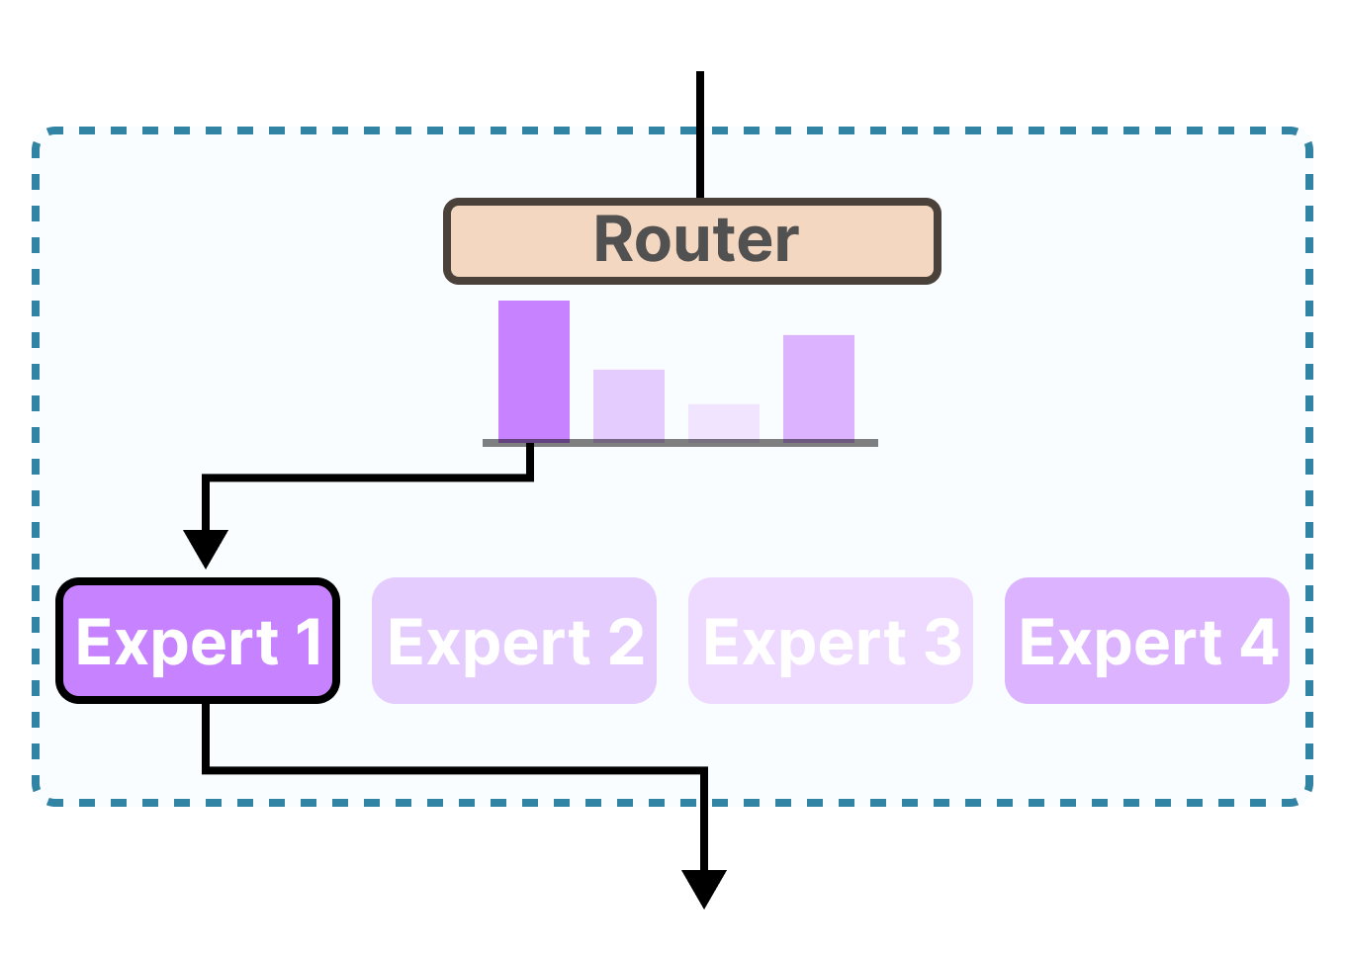
Recent Architectural Innovations
Mixture of Experts
We have a multiplex design, where the input determines which network component is activated to process and generate a prediction.
Originally, this was ‘hard routing’ (softmax argmax), but more recently, it has become soft routing (just softmax), and we take weighted averages of expert output.
This adds a lot of overhead to the model, so inference is expensive/slow. Deepseek innovated on this and ‘learned’ the routing rule (or its approximation) after training and made a new network that fixes the routing rule.

Slide 18




Generative Image, Audio, Video Models
Generative Models Have Taken Off
Text-to-Image: Midjourney, Stable Diffusion, DALL-E, etc.
Text-to-Video: Sora, Veo3
Audio + Photo to Video: Kling
Text to Voice: ElevenLabs

Slide 19
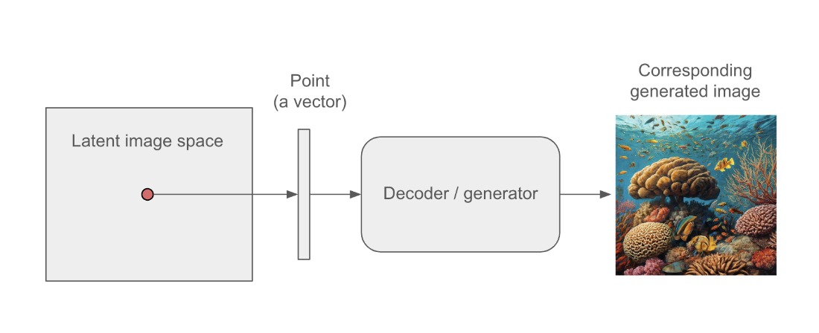
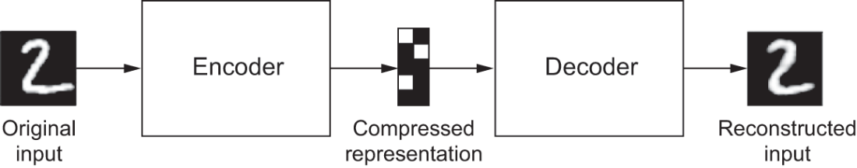
Generating Images
Variational Auto-encoders: VAEs employ an auto-encoder architecture (similar to our translation case, or the image-sharpening example) to compress and recover the input image. The trick is in the architecture we use to capture the compression.

Slide 20
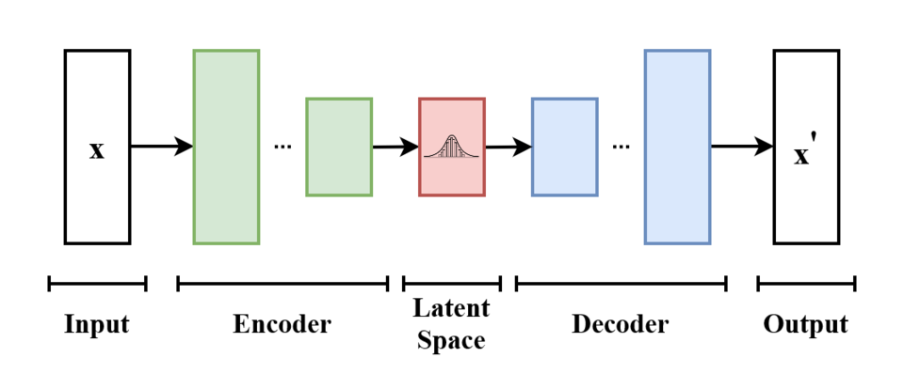
Variational Auto-encoder (VAE)
Mapping Images to a Vector of Latent Distributions
We learn to map each image in our training data to a distribution over latent variables — typically a Gaussian with a learned mean and variance.
We do this in a self-supervised way, using an auto-encoder architecture. The model architecture compresses the input image down into a vector that represents mean and variance values in several embedding dimensions and then converts that latent representation back to an image.

Slide 21
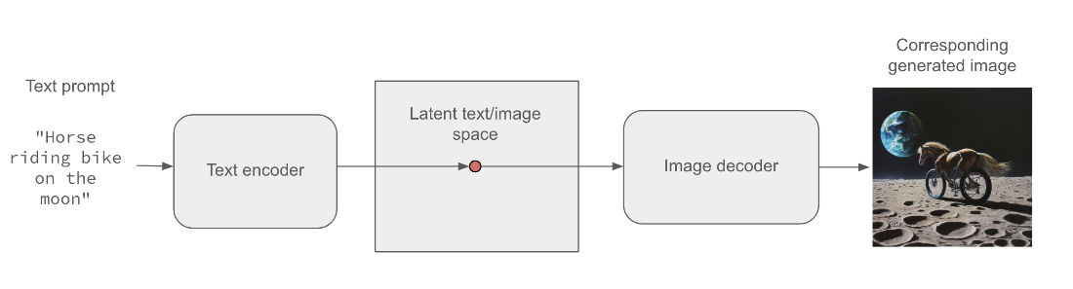
Conditional VAE (Guiding with Text)
We train the model by passing it an image along with textual captions. The image is projected into the latent space as a set of means and variances in a way that considers the text (conditional on the text). The decoder then samples from the normal distributions specified at that point in the latent space and attempts to reconstruct the input image, again taking the caption as input.
At inference, we drop the encoder and randomly sample from the latent distributional space (synthesize a random vector of values). We use that, along with a textual prompt, to synthesize a new image.
Notes:
This is how a Conditional VAE works.

Slide 22
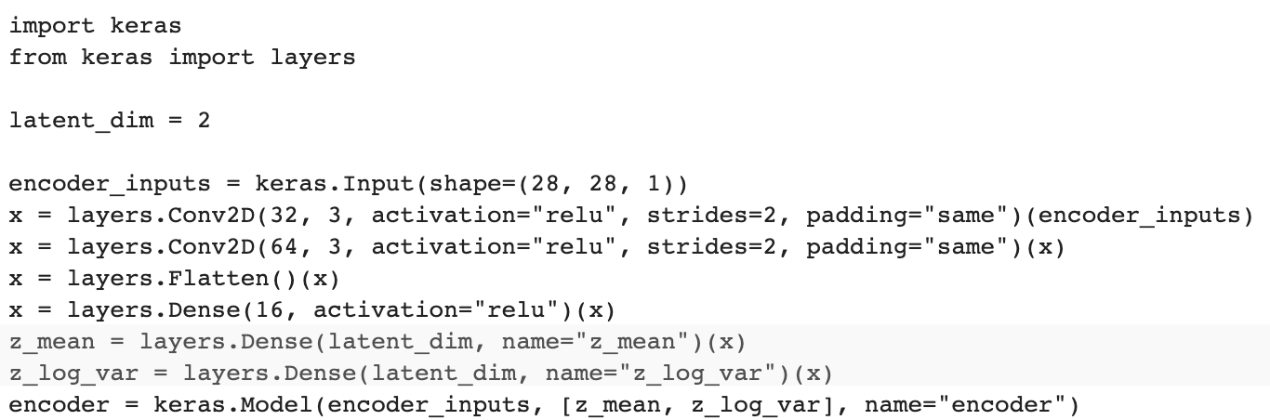
Encoder Portion
The encoder portion takes in the image and compresses it with convolutions (like our image sharpening task). We then have two ‘stand-in’ hidden layers intended to capture a multivariate normal distribution (means and variances associated with each embedding dimension).

Slide 23
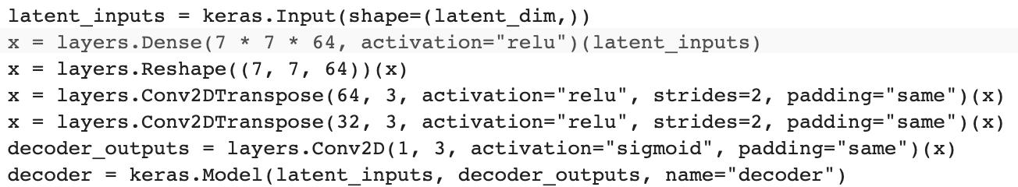
Decoder Portion
The decoder portion takes in a point in the latent distribution and up-samples that into an image.

Slide 24
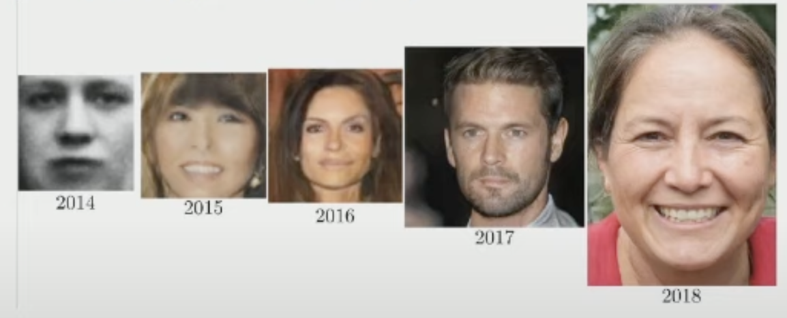
Generative Adversarial Networks (GANs)
GANs are a Powerful Flexible Tool for Generative Modeling
What is a GAN? How do GANs work?
What problems can we address with GANs?
How do we implement a GAN?
Notes:
https://www.youtube.com/watch?v=G06dEcZ-QTg

Slide 25
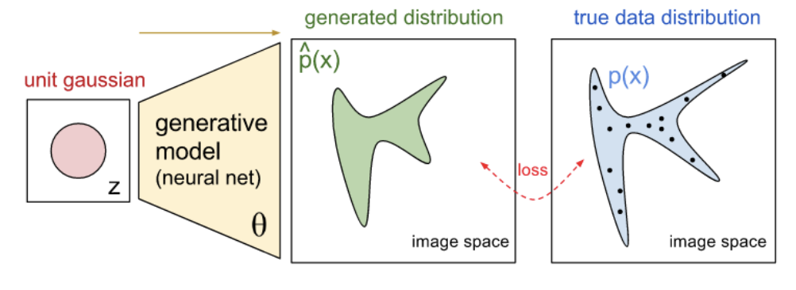
The Goal
Synthesize Samples That Conform to the Real Data’s Distribution
We train a network to produce synthetic samples that are indistinguishable from true samples.
More concrete, this means we train a network to learn the probability distribution of real data.
For example, learn the joint probability distribution of pixel values in a set of images.
So, the resulting network could take a random vector of noise as input, and map it to a synthetic output that looks very similar to real data.

Slide 26
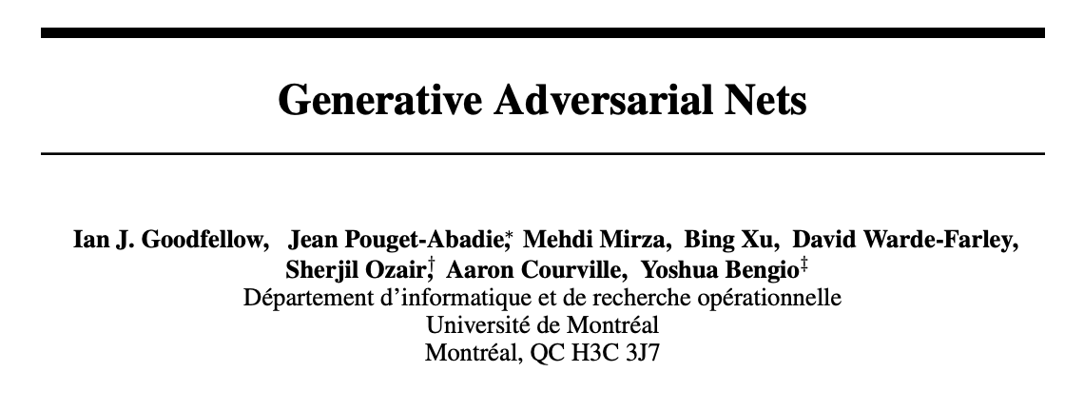
How Might We Do This?
A Neural Net That Produces Image Output
Take in a random vector as input, and have it produce image predictions.
Next, compare those predictions with authentic images. But how?
We don’t want it to try to predict a specific image, because then it won’t be able to produce new synthetic examples.
The problem? The loss function is highly complicated.
A solution…
Notes:
We pair a discriminator with the generator. Discriminator is a standard network we’ve seen before; it’s a classifier. It takes in an image, and predicts whether the image is real or fake.

Slide 27
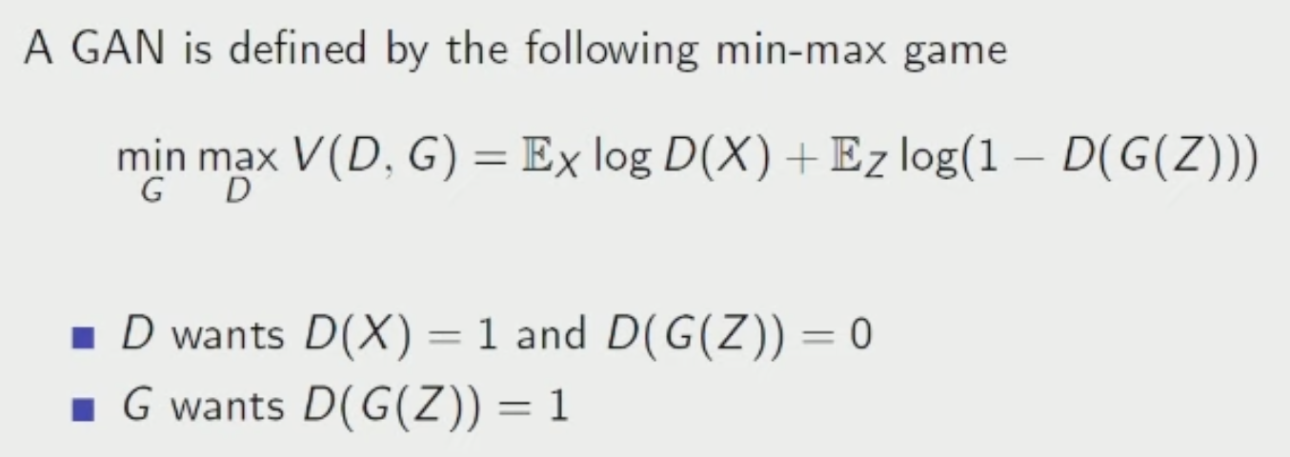
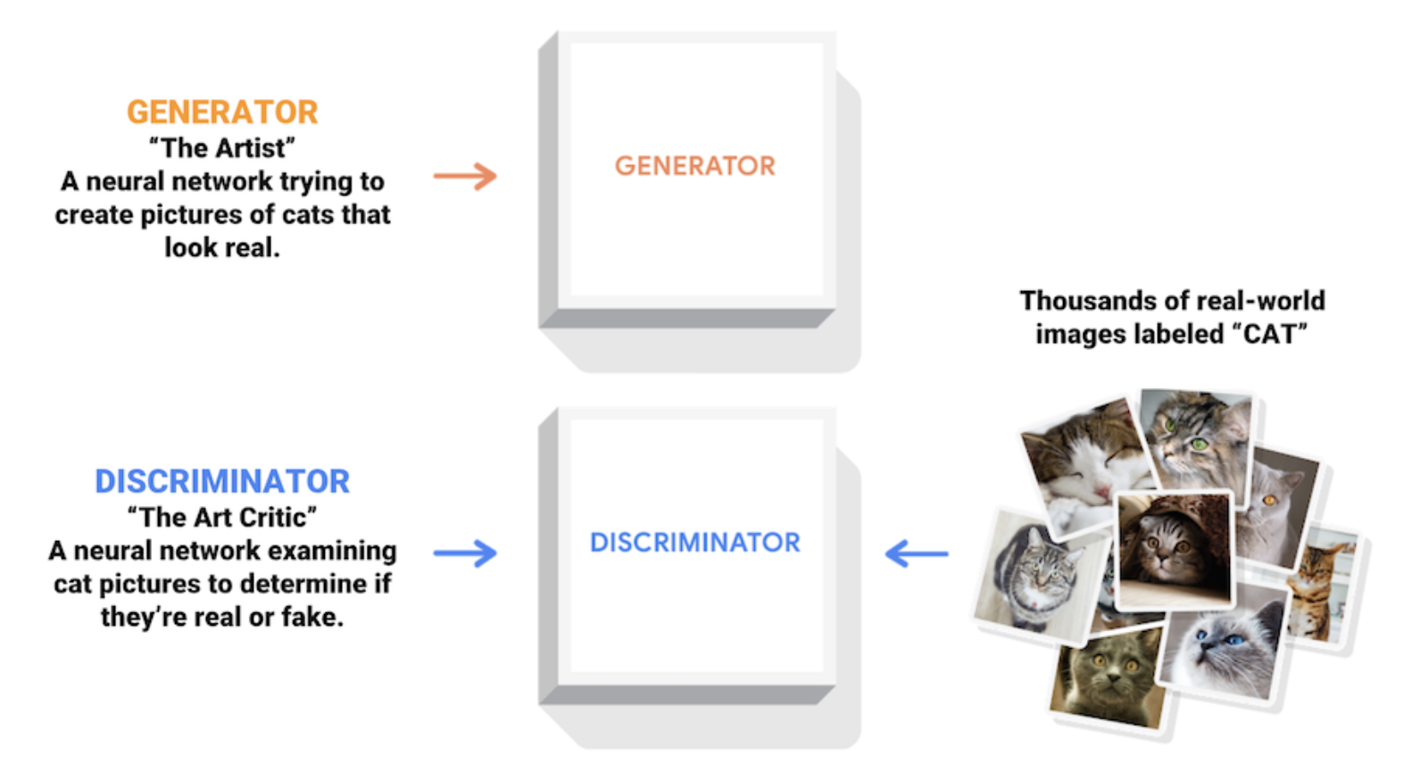
Adversarial Architecture
Discriminator
Serves as an adaptive loss function for the generator.
It’s a throw-away network that is just there to help train the generator.
Notes:
We pair a discriminator with the generator. Discriminator is a standard network we’ve seen before; it’s a classifier. It takes in an image, and predicts whether the image is real or fake.

Slide 28
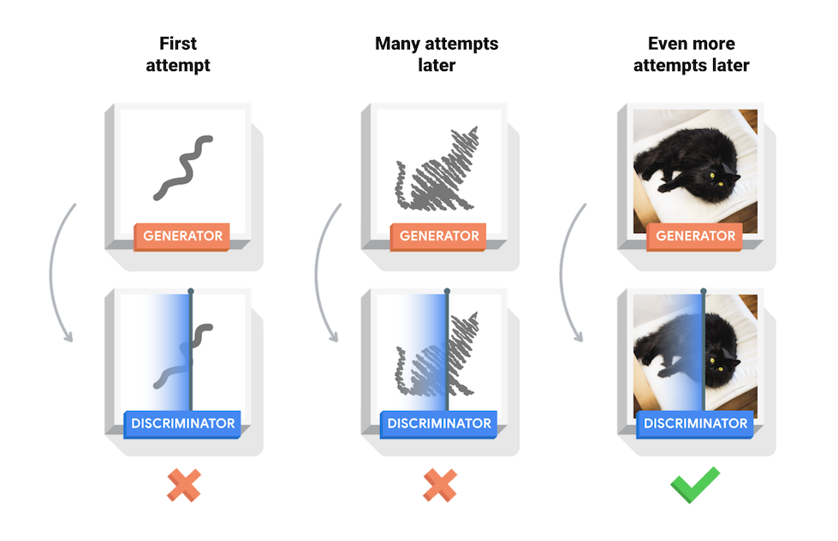
Adversarial Architecture
Notes:
We pair a discriminator with the generator. Discriminator is a standard network we’ve seen before; it’s a classifier. It takes in an image, and predicts whether the image is real or fake.

Slide 29
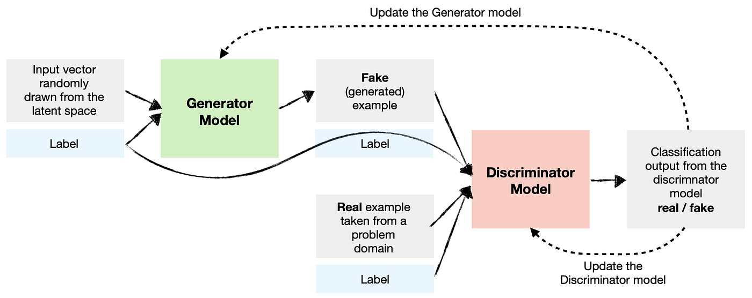
Conditional GANs
GAN /w Labels as Input Too
We don’t want our GAN to just learn P(X); it needs to learn P(X|Y).
This is a simple modification; we give two inputs to the generator, a label and a noise vector. So, it tries to produces images that match real images given a particular label, rather than images in general.
End result is a generator that you can pass a noise vector and a label, and it spits out an image of that label.
Notes:
We pair a discriminator with the generator. Discriminator is a standard network we’ve seen before; it’s a classifier. It takes in an image, and predicts whether the image is real or fake.

Slide 30
Questions?
Notes:
Weights are not initialized until you “build” the model (or compile it, which will first build).

